Slide 1
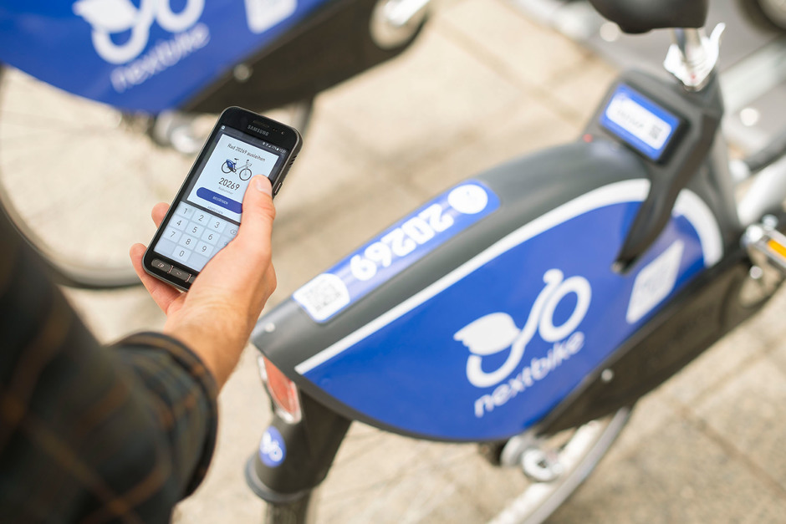
Project Report
PROGRAMMING DATA SCIENCE
University of Cologne – Manuel Gassner, Long Le, Irene(Jiaying) Xu

Slide 2

Project Design
Prediction & Classification
4
Predictors, Model Creation, Model Testing, Possible Justification
Conclusion & Discussion
5
Conclusion,
Suggestion for future analysis
Data Analysis
3
Statistical Analysis,
Data Visualization, etc.
Data Processing
2
Introduction
Initial Data Exploration,
Data Cleaning, Data Manipulation
1
Project Timeline, Team Responsibilities,
Project Overview

Slide 3
Team Members and Responsibilities
Manuel Gassner
Irene Xu
Long Le
Business understanding
Data understanding
Code refactoring
QA
Descriptive analysis of data
Creation and evaluation of the prediction models
Handling scm (GIT)
Business understanding
Data understanding
Code refactoring
QA
Descriptive analysis of data
Creation of report and presentation slides
Data description
Business understanding
Data understanding
Code refactoring
QA
Descriptive analysis of data
Data Visualization
Creation of report and presentation slides
Creation and evaluation of the prediction models

Slide 4
Project Timeline
Business
Understanding
Data
Preparation
Data
Visualization
Modelling
Validation
& Evaluation
Report & Slides
Creation
Test result
& Presentation
Present -
Phase 1
23.05.2020 -
Business Understanding – 2 days
Data Preparation / Understanding – 2 weeks
Data Visualization – 1 week
*Creating & maintaining the git repo
Phase 2
02.06.2020 -
Model Creation –
1 week
*Code refactoring
*Maintaining the git
repo
Phase 3
08.06.2020 -
Evaluation – 3 days
Report & Slides Creation – 3 days
*Cleaning up the git repo
Phase 4
Getting test data
Presentation
Manuel Gassner
Irene Xu
Long Le
Manuel Gassner
Irene Xu
Long Le
Manuel Gassner
Long Le
Irene Xu
Long Le

Slide 5
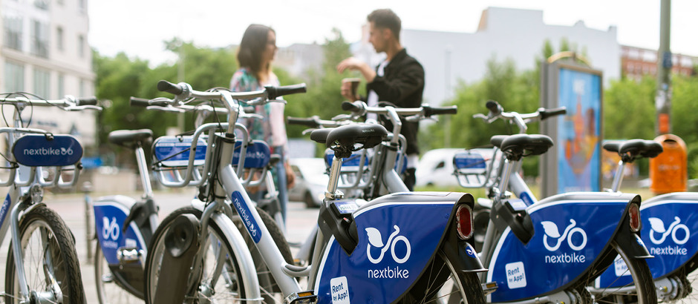

Introduction
Nextbike is a German company that produces and operates bike sharing systems around the world.
Bike-sharing is one of the fastest growing transportation services
The ability to predict bike-sharing patterns allows service providers to be more efficient and cost-effective
This project examines the 2019 NextBike’s trip data of bike usage in Frankfurt and constructs prediction models of usage patterns.
The goal is to explore how the bike sharing systems are used, and to gain insights into the complex bike sharing activity patterns.

Slide 6
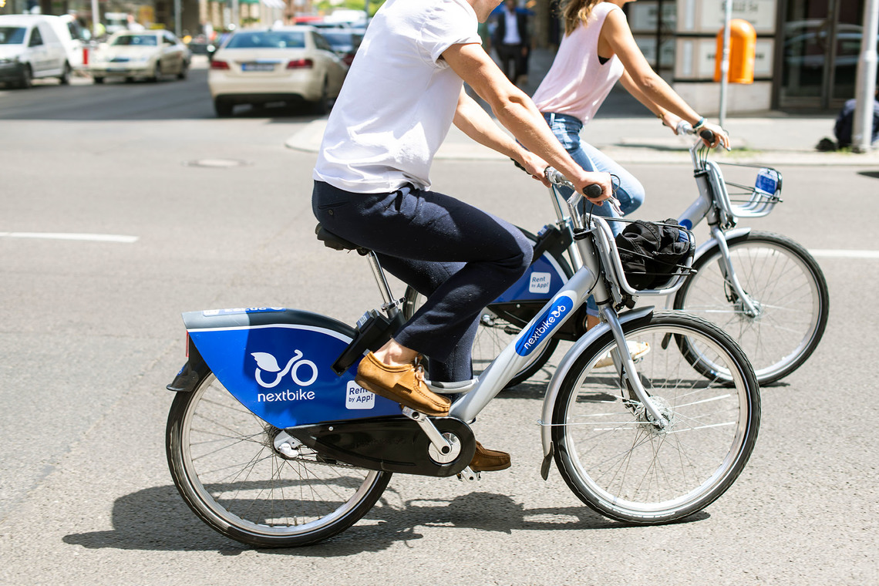
Data Processing
The data set covers approximately 532,000 entries of the year 2019. There are 13 columns in total, the types and meanings of the columns are stated in following Table.
Variable Name | Format | Description
b_number | int64 | ID of the bike being rented
b_bike_type | float | Types of the bike, there are 4 types of bike
p_spot | bool | If the bike is in the bike station, T = in station, F = not in station
p_bike | bool | If the bike is floating, T = in, F = not floating
p_name | object | Human readable name of the bike station
p_number | float | ID of the bike station
p_place_type | int64 | Types of places, e.g., 7 = hotels, 3 = education institutions
p_uid | int64 | Unique ID of the location
p_bikes | int64 | The number of available bikes in the station
p_lat | float | latitude of the start/end location
p_lng | float | longitude of the start/end location
datetime | object | YY-MM-DD 00:00:00, date-time of the booking
trip | object | Status of the booking (start/end, first/last)
Table 1: Variables of NextBike’s data set

Slide 7
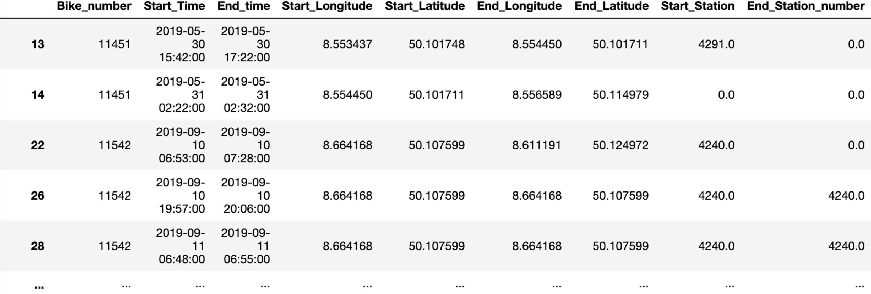
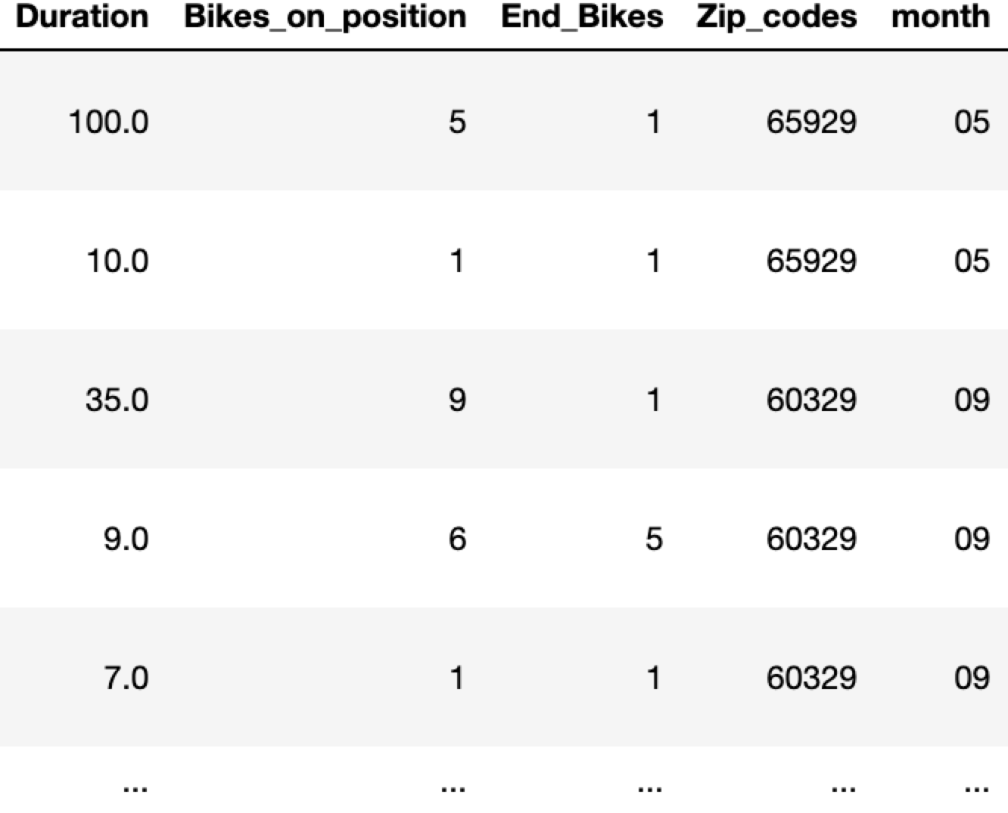
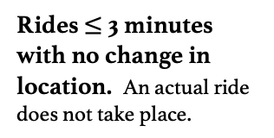
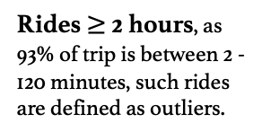
Data Cleaning
Rides that show negative/wrong coordinates. This could happen if an error occurs at the bike station/spot while returning a bike.
Rides $≤$ 3 minutes with no change in location. An actual ride does not take place.
“First” and “last” data that only represent the availability of the bike but not the actual trip data.
Rides $≥$ 2 hours, as 93% of trip is between 2 - 120 minutes, such rides are defined as outliers.
Rides that have more than one “start” or “end” data, where the bike is already occupied and a start booking appears when the later booking is dropped
Other outliers,
e.g., batch bookings that caused by bike reallocation
*Data objects that show the above characteristics are removed from the original data set
New DataFrame

Slide 8

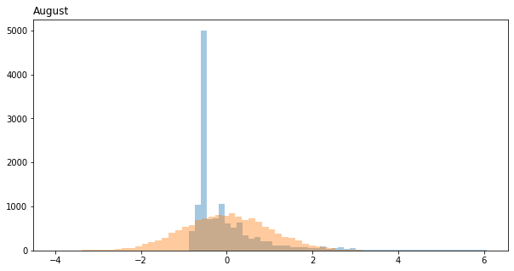
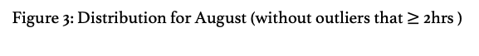
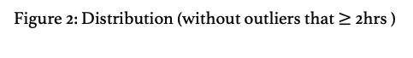
Descriptive Analysis - Outliers
Rides $≥$ 2 hours, as 93% of trip is between 2 - 120 minutes, such rides are defined as outliers.
Figure 1: Distribution (with outliers)
Figure 2: Distribution (without outliers that $≥$ 2hrs )
Figure 3: Distribution for August (without outliers that $≥$ 2hrs )
*Range from 2 minutes to 1394 minutes

Slide 9
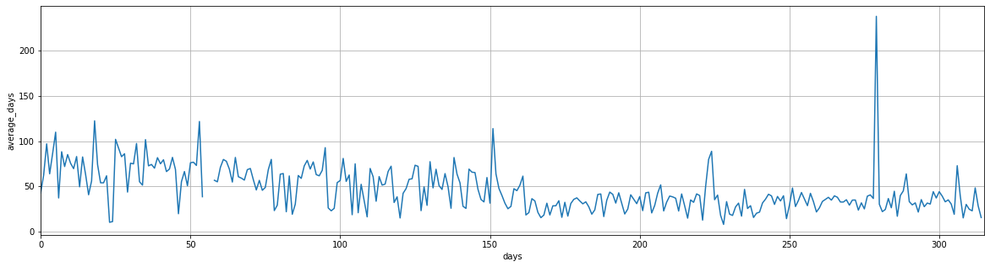
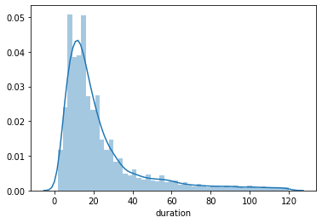
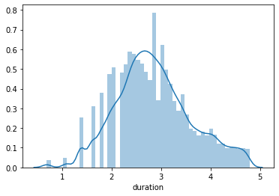
Descriptive Analysis - Outliers
26th November
A “batch” booking of 250 bikes for 384 minutes on the same time at 1 a.m.
Assumption: Reallocation of bikes to the station by Nextbike’s employees
Remaining
trip data: 51,393
Entries / Trips
Figure 4: Weekly average duration by days
After dropping all the outliers that would affect our predictions, the overall distribution shape for the remaining 51,393 trips goes close to the shape of the normal distribution.
We will use the data set with a log transformation of the target value for our further analysis prediction.
Figure 5: The distribution of duration <120 before log transformation
Figure 6: The distribution of duration <120 after log transformation

Slide 10
MONTHLY
Descriptive Analysis – Aggregate Statistics
Seasonal Trend
More trips in summer month (June, July, August) than winter month (Dec, Jan, Feb).
Lower demand for bike sharing services in winter month.
Weekends vs. Weekdays
(Except winter month), longer trip duration on weekends; shorter trip duration on weekdays.
More trips occurred on weekdays ; less trips occurred on weekends.
Possible travel patterns:
In general, the weekday bike travel is more in favor compared to weekend bike travel when there’s a commuting need.
Figure 7: Monthly aggregate statistics

Slide 11
WEEKLY
Descriptive Analysis – Aggregate Statistics
Weekends vs. Weekdays
Longer trip duration on weekends; shorter trip duration on weekdays.
More trips occurred on weekdays (+Saturday); less trips occurred on Sunday.
Possible travel patterns:
Weekend travel behavior is different from the weekday travel behavior.
Figure 8: Weekly aggregate statistics

Slide 12
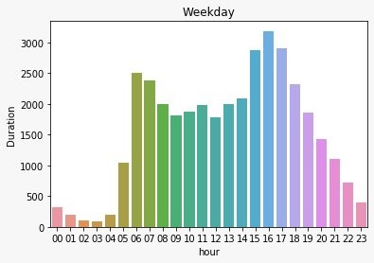
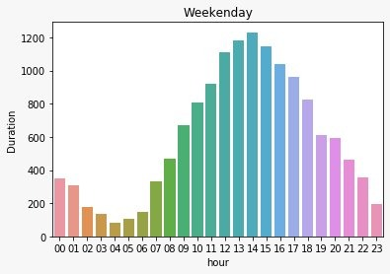
HOURLY
Descriptive Analysis – Aggregate Statistics
Hourly Difference
The average duration reaches its peak in the morning commuting hours between 8-10 o’clock (go to work or go to school) and 12 o’clock (lunch hour), whereas the trough is from midnight to early morning.
Weekends vs. Weekdays
People are more likely to use the shared bike in the afternoon (12-3pm) on weekends, and in the commuting hours (6am-8am) on weekdays.
Possible travel patterns:
Weekday bike travel is more in favor compared to weekend bike travel in commuting hours
Figure 9: Hourly aggregate statistics

Slide 13
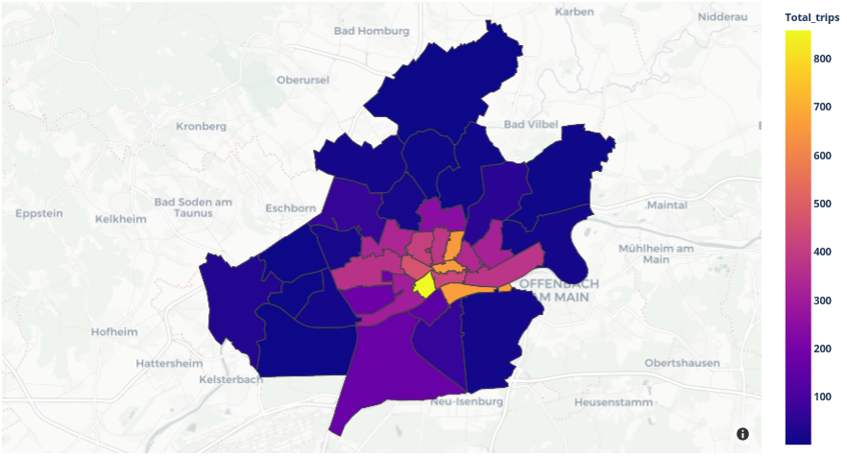
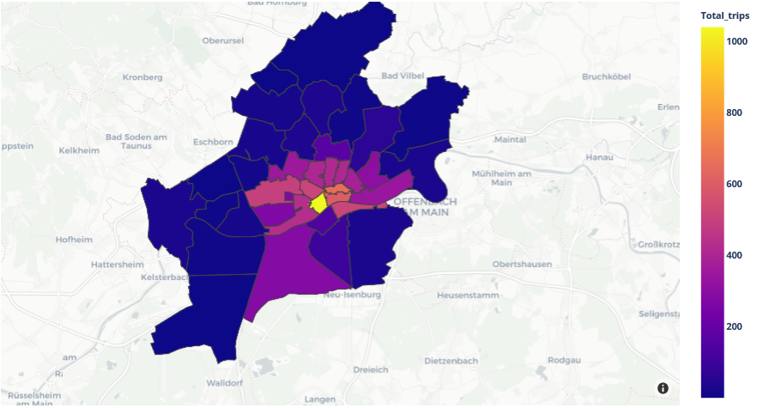
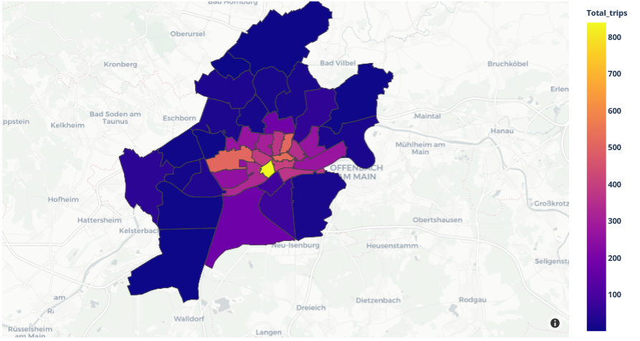
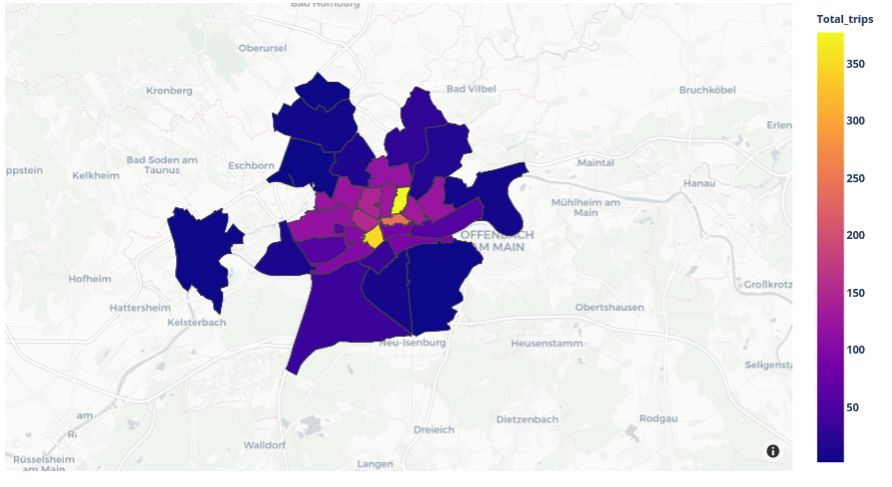
Data Visualization
Geographical distribution of starting locations of the trips in summer months
June
August
September
December
Figure 10: Map of started trips by Postal Region in June, August, September, December, 2019
Pattern
More trips are generated within the city center than the surrounding areas.
In other words, the closer the region is to the city center, the more trips are generated in that region.

Slide 14
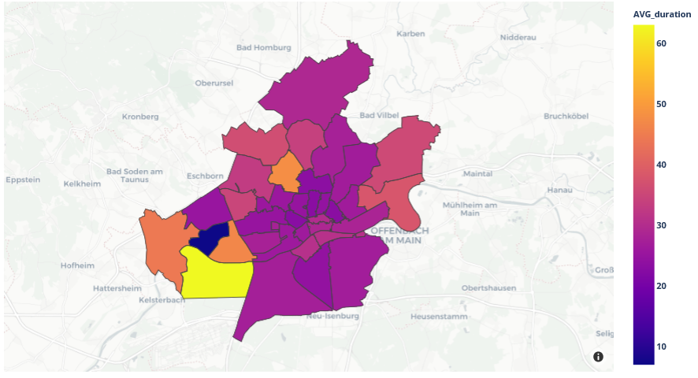
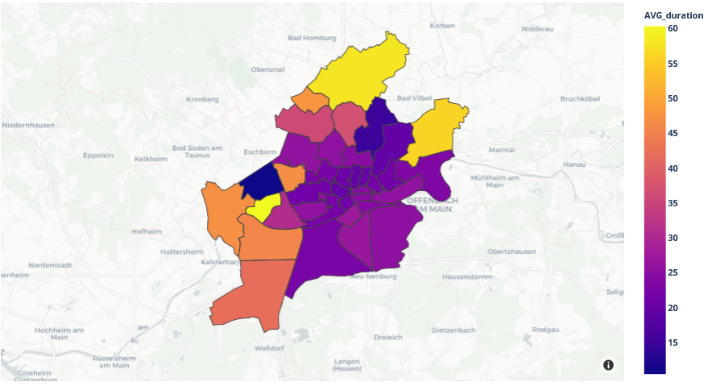
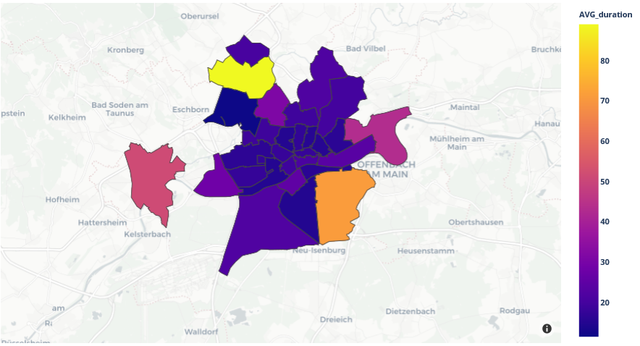
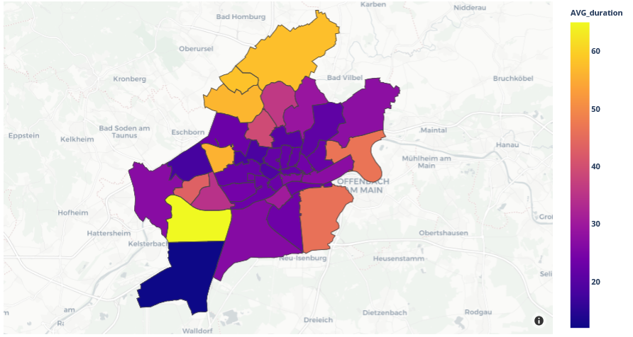
Data Visualization
Average duration of the trips by the starting PLZ regions
June
August
September
December
Figure 11: Map of average trip duration by started Postal Region in June, August, September, December, 2019
Pattern
The average duration of trips that started in the center regions were shorter than that of trips started in the border regions. We hypothesized that the region from which the trips started (Border_district) could be a predictor for trip duration.

Slide 15


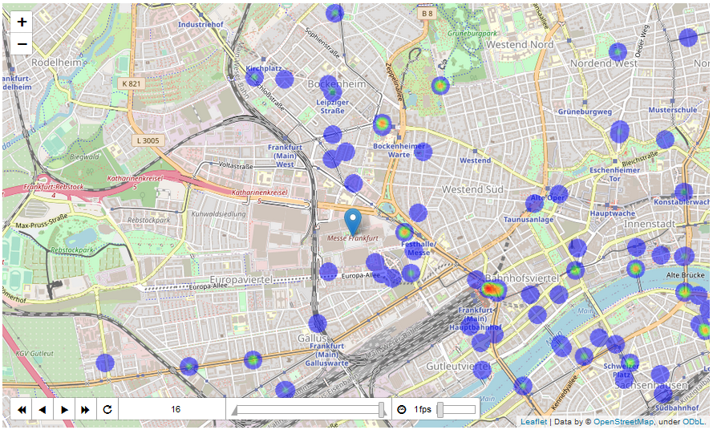
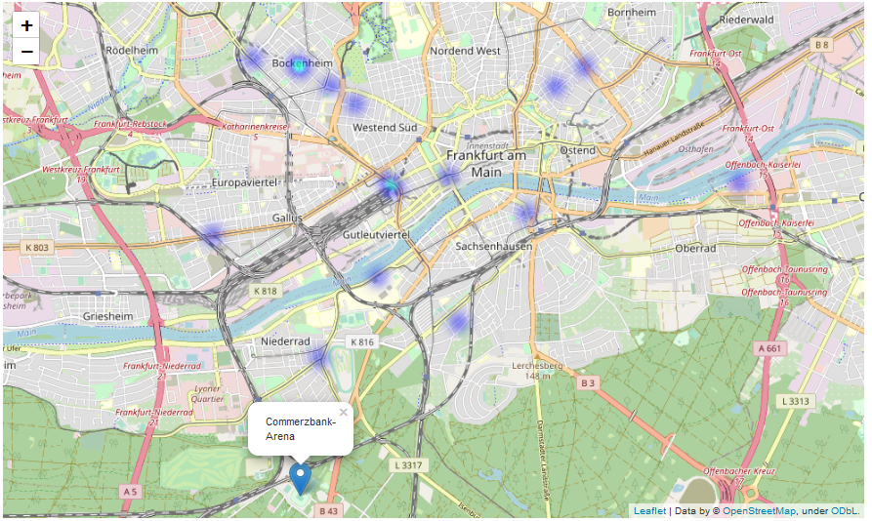
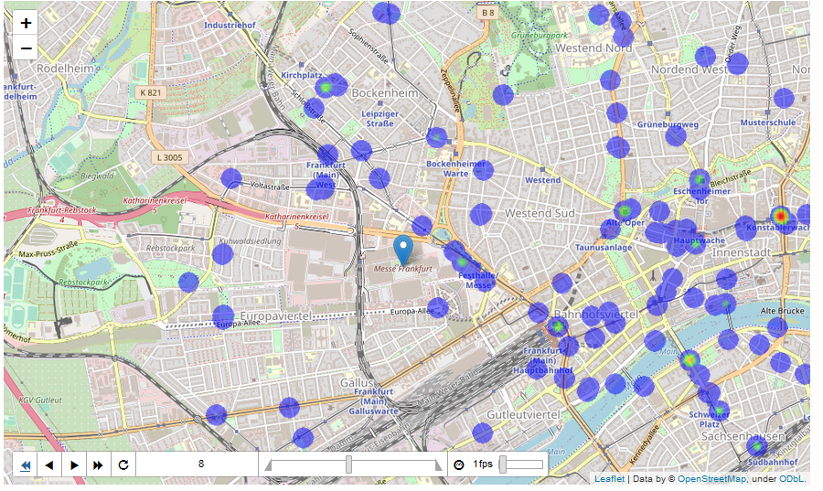
Data Visualization
Explore whether people would use bikes to travel to public events.
Location: Messe Frankfurt exhibition center
Visit day: From 12 to 22 September, 2019
Visit hours: Daily from 09:00 am to 07:00 pm, 20th of September from 11 am to 9 pm
Football match, Eintracht Frankfurt vs. Dortmund
Location: Commerzbank-Arena, Frankfurt
Date and time: 18:00 CEST on 22 September, 2019
Attendance: 51,500
Figure 12: Heatmap of the end trips near the exhibition center on Saturday, 14 September 2019.
Figure 13: Heatmap of the end trips 1.5 hours before the football match between Eintracht
Frankfurt and Dortmund started on 22 September, 2019

Slide 16
Data Visualization
Explore whether people would use bikes to travel to public events.
Location: Messe Frankfurt exhibition center
Visit day: From 12 to 22 September, 2019
Visit hours: Daily from 09:00 am to 07:00 pm, 20th of September from 11 am to 9 pm
Football match, Eintracht Frankfurt vs. Dortmund
Location: Commerzbank-Arena, Frankfurt
Date and time: 18:00 CEST on 22 September, 2019
Attendance: 51,500
Figure 14: Heatmap of the end trips near the exhibition center on the last day of the event.
Figure 15: Heatmap of the end trips 1.5 hours before the football match between
Eintracht Frankfurt and Dortmund started on 22 September, 2019

Slide 17
Data Visualization
Explore whether people would use bikes to travel to public events.
Location: Messe Frankfurt exhibition center
Visit day: From 12 to 22 September, 2019
Visit hours: Daily from 09:00 am to 07:00 pm, 20th of September from 11 am to 9 pm
Football match, Eintracht Frankfurt vs. Dortmund
Location: Commerzbank-Arena, Frankfurt
Date and time: 18:00 CEST on 22 September, 2019
Attendance: 51,500
There were trips that ended next to the exhibition center during the opening hours.
Weekends captured more trips to the event location than that of normal.
As the event came closer to its end, more trips that ended near the exhibition center were captured in the map.
Interestingly, 2 days before the first opening day, there were trips that ended inside the exhibition center. This could be explained that event staff and volunteers might have organized their preparation meeting before the event started.
To investigate if people commuted to the football match using bikes, data for the trips that ended 1.5 hour before the match started was employed in the visualization.
In contrast to the IAA event, the map shows nearly no bike trips ended near the Commerzbank-Arena before the match started.
The location of the Commerzbank-Arena might be a decisive factor in this case, as the stadium was far from the city center, the bike route to commute from the city center to the stadium might be difficult.
Figure 14: Heatmap of the end trips near the exhibition center on the last day of the event.
Figure 15: Heatmap of the end trips 1.5 hours before the football match between
Eintracht Frankfurt and Dortmund started on 22 September, 2019

Slide 18
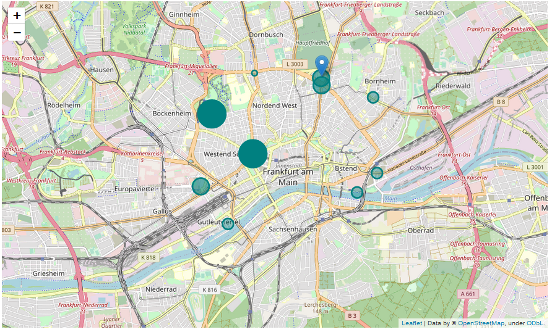
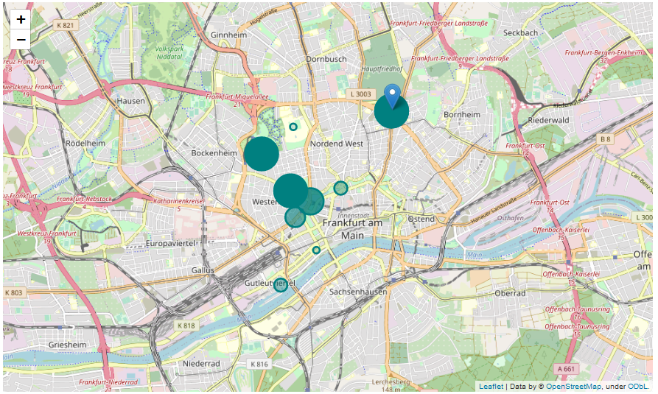
Data Visualization
Explore if students used bikes to travel to university.
Figure 16: Map of the number of bikes at fixed station from 7AM to 8AM on May 03, 2019.
Figure 17: Map of the number of bikes at fixed station from 7AM to 8AM on May 08, 2019.
Pattern
From 7AM to 8AM (before normal lecture time) on the selected days (May 03 and May 08th 2019, normal weekday), the stations near the University of Applied Sciences were among the top stations with more bikes.

Slide 19
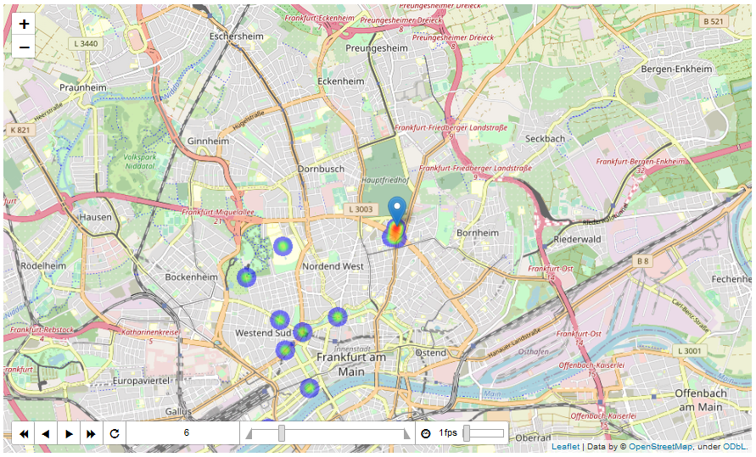
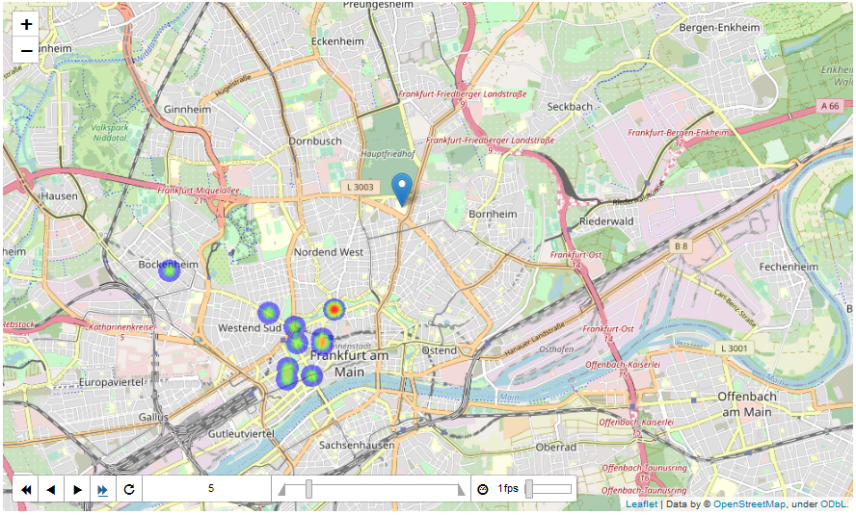
Data Visualization
Explore if students used bikes to travel to university, monthly analysis
Figure 18: Heatmap of the location of the trips that ended from 7AM to 8AM on May 08, 2019.
Figure 19: Heatmap of the location of the trips that ended from 7AM to 8AM on August 05, 2019.
Pattern
The areas near the University of Applied Sciences were the top popular locations for bike trips to end from 7AM to 8AM in most of the days in May, September, and October (except for weekends and public holidays). In contrast, August has very few trips ended near the university location from 7AM to 8AM.
Such pattern could be explained by the fact that August is the summer vacation for university students. When the spring semester ends on August 1st, there were many trips that ended near the university captured. But after that, very few trips ended within the selected time frame.

Slide 20
Predictors – for prediction model
to predict trip duration
LAST HOURLY
AVG. DURATION
The average trip duration of the last 4 hours prior to the trip starts; 4 variables separated by hour
TEMPERATURE
Temperature per hour in Celsius degree
BORDER_DISTRICT
zip codes of the start positions
(Binary)
START TIME
A day is separated into 4 time intervals as binary variables
WEEKDAY
Day of the week,
weekdays vs. weekends (binary)
LAST DAILY
AVG. DURATION
Average duration of the last 2 days prior to the trip starts; 2 variables separated by day

Slide 21
Predictors - for classification model
to classify if a trip is travelling towards the university
ZIPCODE_PRO
Probability with reference to the past trips' start stations (by area/zip code)
STUDENT_QUARTER
(binary) parameter = 1 if the zip code of the starting position had a student dormitory
BORDER_DISTRICT
zip codes of the start positions
(Binary)
DISTANCE_UNI
Distance towards universities; numerical value in kilometers
WEEKDAY
Day of the week,
weekdays vs. weekends (binary)
WEATHER
(Binary) parameter = 1 for good weather;
STATION_PRO
Probability with reference to the past trips' start stations
(by station)
0 for bad weather.

Slide 22
Prediction Methods
Prediction Model
Classification Model (Neural network)
… to predict trip duration
… to classify if a trip is travelling towards the university
1st HIDDEN LAYER
2nd HIDDEN LAYER
3rd HIDDEN LAYER
INPUT
LAYER
OUTPUT
LAYER
INPUT #1
INPUT #2
INPUT #3
7 NODES
*To avoid overfitting we used a 0.1 dropout rate in the hidden layers.
INPUT #17
Figure 5: The distribution of duration <120 before log transformation
Figure 6: The distribution of duration <120 after log transformation
Notes:
For the trip duration prediction we developed a linear regression model and used a log transformation for the target value to issue the right skewed distribution and the not linear relationship between the target and the predictor values. Since our analysis showed the relationship between the target and the predictors is not linear.
For the creation of the classification model to predict the journey direction towards the university, we will use a neuronal network with 1 input layer with 17 nodes and 3 hidden layers with 17 nodes with a sigmoid activation function and one output layer with one node. To avoid overfitting we used a 0.1 dropout rate in the hidden layers.

Slide 23
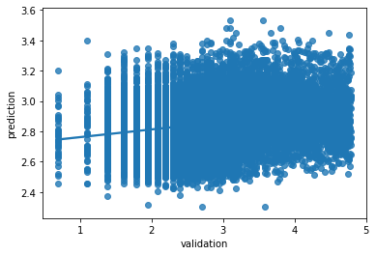
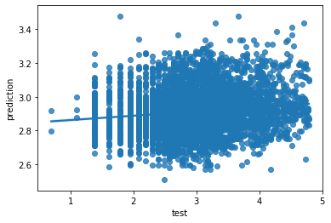
Evaluation for Prediction Model
Metrics used to evaluate models performance:
Mean-absolute-error (MAE): general miss on prediction in minutes
Root-mean-square-error (RMSE): used to detect outliers
R², indicator for the degree of generalizability of the model.
Metrics | Validation Set | Test Set
MAE | 13 mins | 15.7 mins
RMSE | 21 mins | 15.98 mins
R² | 0.051 | 0.014
Figure 20: performance of prediction model (validation set)
Table 2: The metrics results for model evaluation (prediction model)
Findings
Underfitted model
Prediction on average far of real values
Reengineering required for model and predictors
Model did not fit the underlying data structure
Figure 21: performance of prediction model (test set)
Notes:
our assumption about our predictors are wrong. For an improvement of the model the predictors have to be expanded to get better results.

Slide 24
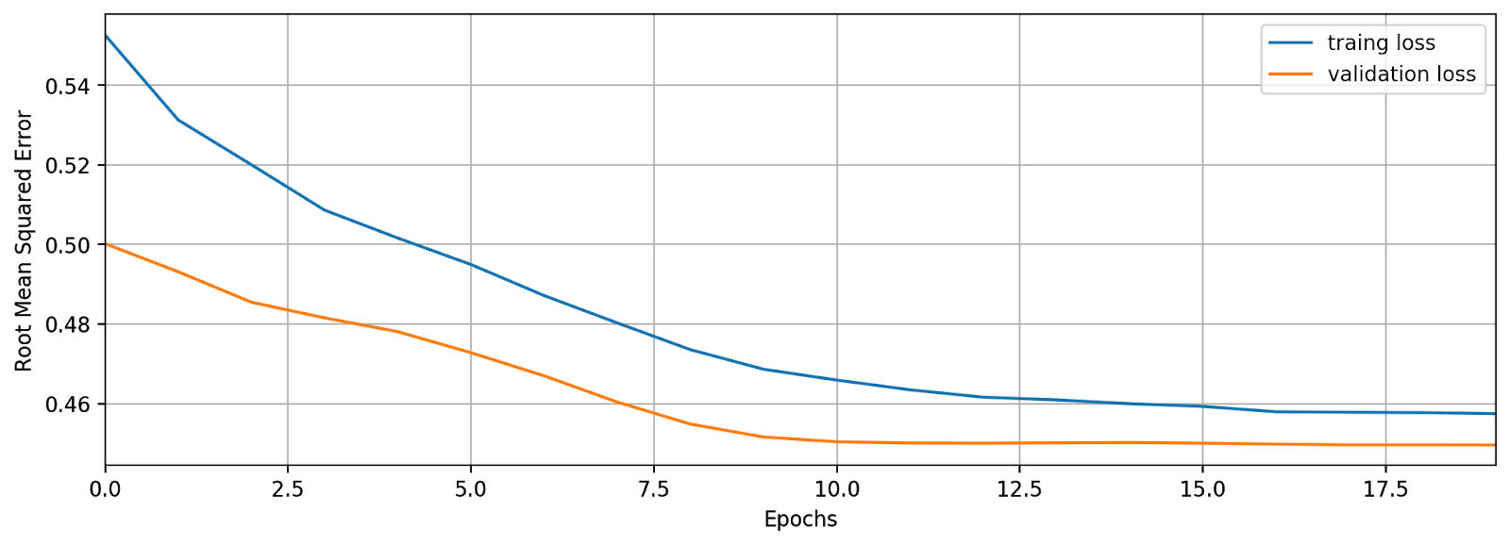
Evaluation for Classification Model
Metrics used to evaluate model performance:
Confusion matrix shows us how good the model classifies the data
Confusion matrix | Validation Set | Test Set
True/Positive | 5208 | 2213
True/Negative | 3511 | 1443
False/Positive | 3993 | 1030
False/Negative | 2706 | 711
Classification Accuracy | 0.52% ~ 52% | 0.667% ~ 68%
Table 3: The confusion matrix results for model evaluation (classification model)
Figure 22: The loss and validation lost of the models with their number of epochs
Findings
Better performance on test set
Results not clear
Small test set
Blackbox mentality of neuronal networks

Slide 25
Conclusion
Higher demand for bike sharing services in summer month
Longer rental period for bike sharing services on weekends.
In general, the weekday bike travel is more in favor compared to weekend bike travel when there’s a commuting need.
Conclusion from Descriptive Analysis
Conclusion from Data Visualization
Higher demand, but shorter rental period for bike sharing services in city center.
University students can be the target users of bike-sharing services.
Public events have impact on NextBike's bike-sharing usage.
Conclusion from Model Development
The data set contains a large amount of outliers, noises, and measurement errors
Unable to find a good indicator for predicting trip duration, or direction towards the universities.
Only in the summer month the temperature seems to show a correlation to the duration of the trips.
The validity of the prediction and classification models fit are questionable, the identification of outliers is crucial for further investigation.

Slide 26
Reference
McLeod, K. (2014). New: Census Data on Bike Commuting. [online] League of American Bicyclists. Available at: https://bikeleague.org/content/new-census-data-bike-commuting
Nextbike GmbH (2020). Frequently Asked Questions. [online] www.nextbike.de. Available at: https://www.nextbike.de/en/faq/.

